Slide 1


Malignant Comment Classification Project
By: Khushboo Khatri

Slide 2
Malignant Comment Classifier Project
Introduction
Problem description /Getting and defining dataset. Quick analysis and summary
Visualization and Preprocessing
Contains EDA, Data cleaning, Data extraction, Data Pre processing (NLP), Finding correlation, Encoding(verctorization)
Model Building
Model building, Evaluation and Conclusion

Slide 3
Introduction
Problem Description:
The proliferation of social media enables people to express their opinions widely online. However, at the same time, this has resulted in the emergence of conflict and hate, making online environments uninviting for users. Although researchers have found that hate is a problem across multiple platforms, there is a lack of models for online hate detection.
Online hate, described as abusive language, aggression, cyberbullying, hatefulness and many others has been identified as a major threat on online social media platforms. Social media platforms are the most prominent grounds for such toxic behaviour.
There has been a remarkable increase in the cases of cyberbullying and trolls on various social media platforms. Many celebrities and influences are facing backlashes from people and have to come across hateful and offensive comments. This can take a toll on anyone and affect them mentally leading to depression, mental illness, self-hatred and suicidal thoughts.
Internet comments are bastions of hatred and vitriol. While online anonymity has provided a new outlet for aggression and hate speech, machine learning can be used to fight it. The problem we sought to solve was the tagging of internet comments that are aggressive towards other users. This means that insults to third parties such as celebrities will be tagged as unoffensive, but “u are an idiot” is clearly offensive.
Our goal is to build a prototype of online hate and abuse comment classifier which can used to classify hate and offensive comments so that it can be controlled and restricted from spreading hatred and cyberbullying.

Slide 4
Dataset Description: The data set contains the training set, which has approximately 1,59,000 samples and the test set which contains nearly 1,53,000 samples. All the data samples contain 8 fields which includes ‘Id’, ‘Comments’, ‘Malignant’, ‘Highly malignant’, ‘Rude’, ‘Threat’, ‘Abuse’ and ‘Loathe’.
The label can be either 0 or 1, where 0 denotes a NO while 1 denotes a YES. There are various comments which have multiple labels. The first attribute is a unique ID associated with each comment.
The data set includes:
Malignant: It is the Label column, which includes values 0 and 1, denoting if the comment is malignant or not.
Highly Malignant: It denotes comments that are highly malignant and hurtful.
Rude: It denotes comments that are very rude and offensive.
Threat: It contains indication of the comments that are giving any threat to someone.
Abuse: It is for comments that are abusive in nature.
Loathe: It describes the comments which are hateful and loathing in nature.
ID: It includes unique Ids associated with each comment text given.
Comment text: This column contains the comments extracted from various social media platforms.

Slide 5
As we get our data from the source provided, for that we need to import necessary library, then getting datasets after that we starts with exploring the data, like getting general summary about dataset, number of rows and columns, their data type, Statistical analysis.
In here we can see that in train dataset we got 8 columns while in test dataset we only got two columns.
Our objective here is to predict the malignant label for test dataset.
However we need to build our model around train dataset, so all the preprocessing which we did in train dataset need to mirrored in test dataset as well.
Also one thing to note here is that our feature is comment_text, so we need to perform NLP operations.

Slide 6
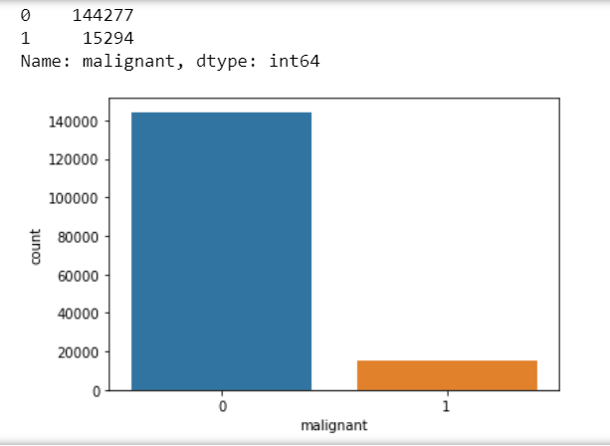
Exploratory Data Analysis
We perform exploratory analysis in two stages: 1) Univariate Analysis 2)Multivariate Analysis.
From above observation we can see that malignant (1) is very low as compared to not malignant(0) in the dataset, which simply means our dataset is imbalanced, and we need to deal with it accordingly.

Slide 7
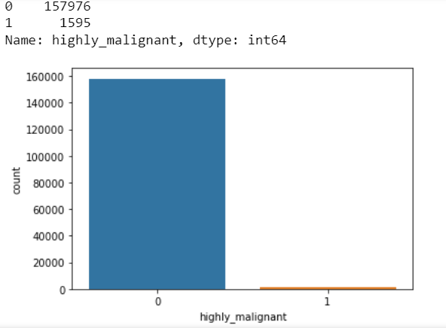
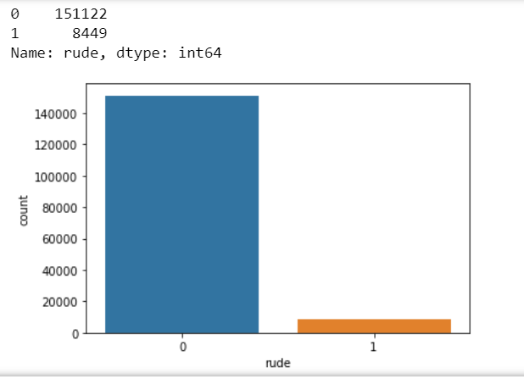
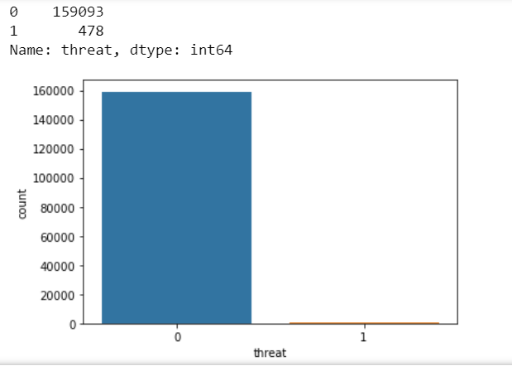
We can observe that rude comments are comparatively higher in number than highly malignant comments
The number of threat comments are extremely less in the entire dataset.
We can observe the distribution of highly malignant comments
Distribution Of Highly Malignant, Rude, Threat comments in the dataset. 1 represent yes while 0 represents no.

Slide 8
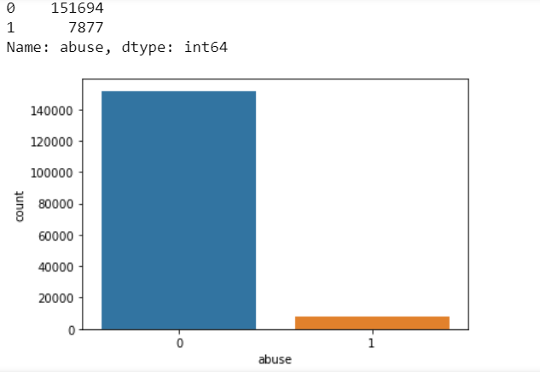
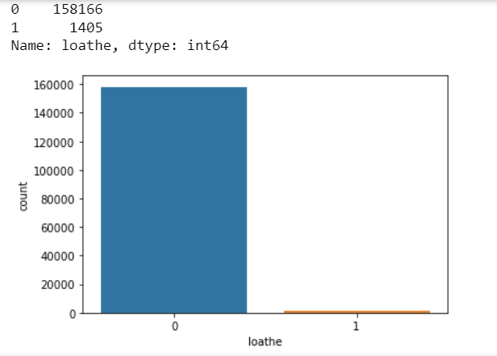
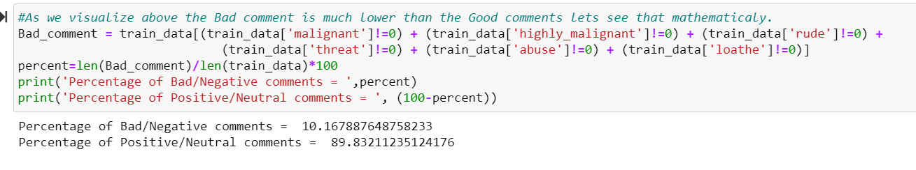
From below plots we can observe that Abuse comments are some what in line of rude comments in the dataset, while again we can observe very small amount of Loathe comments. We can definitely say that number of negative/bad/offensive comments in the dataset is very low as compared to neutral or positive comments. From below calculation we can say that merely 10% of entire data has negative comments.

Slide 9
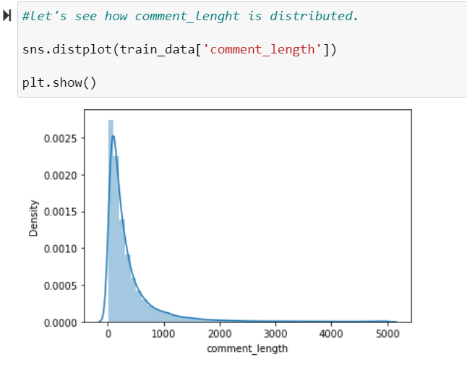
We can see that, most of the comment are with in 650 word limit, there were few very large comment having upto 5000 words.

Slide 10
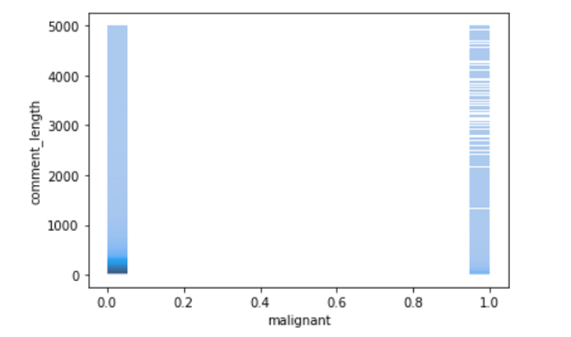
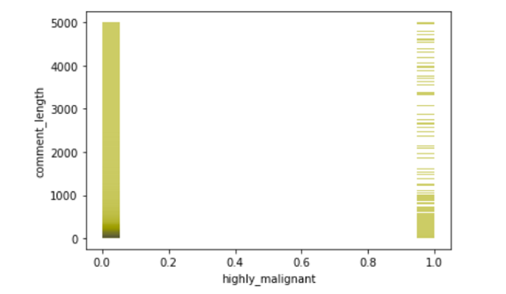
Multivariate Analysis
We can observe that malignant not necessary depends in length of comment_text., let's check for other columns as well.
We can how highly malignant data is distributed on comments lenght. It is not necessary that large comment is highly malignant. Lenght of comment does not defines the higly malignant characteristics of comment_text

Slide 11
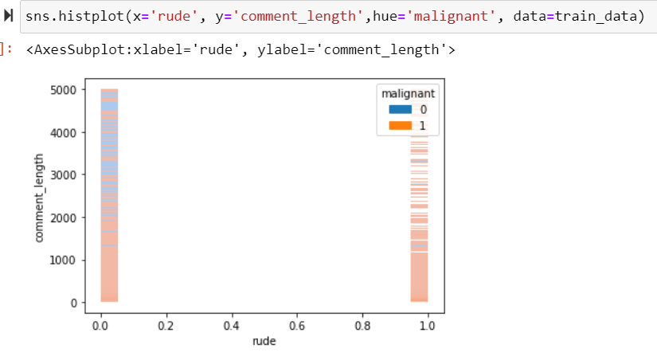
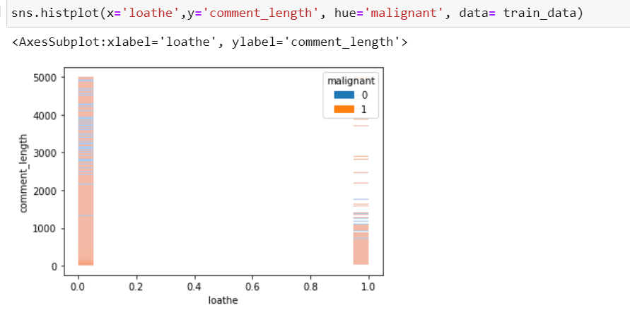
We can observe that some of the rude comments can be malignant as well. From the observation we can say that some of the loathe and malignant comment text are same.

Slide 12
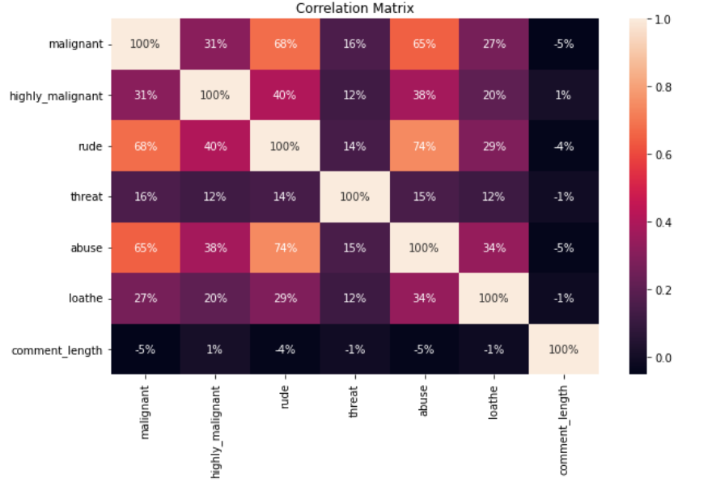
Correlation Matrix
From above observation we can establish the fact that comment_lenght is not much of significant importance. Also, some of the comments has multiple labels. Our focus point here is Malignant and we observe that rude and abuse shows strong correlation with it.
In common man’s term we can say that mostly rude and abusive comments are malignant in nature.
One more thing is seen from here is that threat comments are clearly distinctive. One cannot miss these with other comment easily.

Slide 13
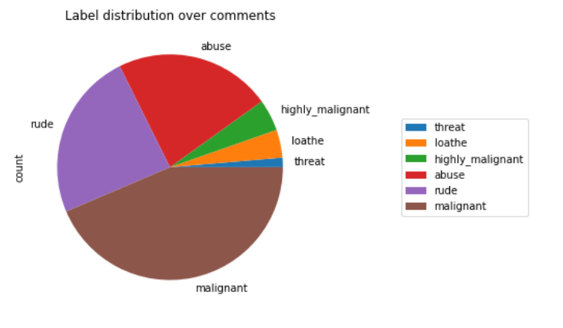
From above observation we can see that most of our comments has malignant as label, and least number of threat comment is present in the dataset. Rude and abuse comments are also good in numbers.

Slide 14
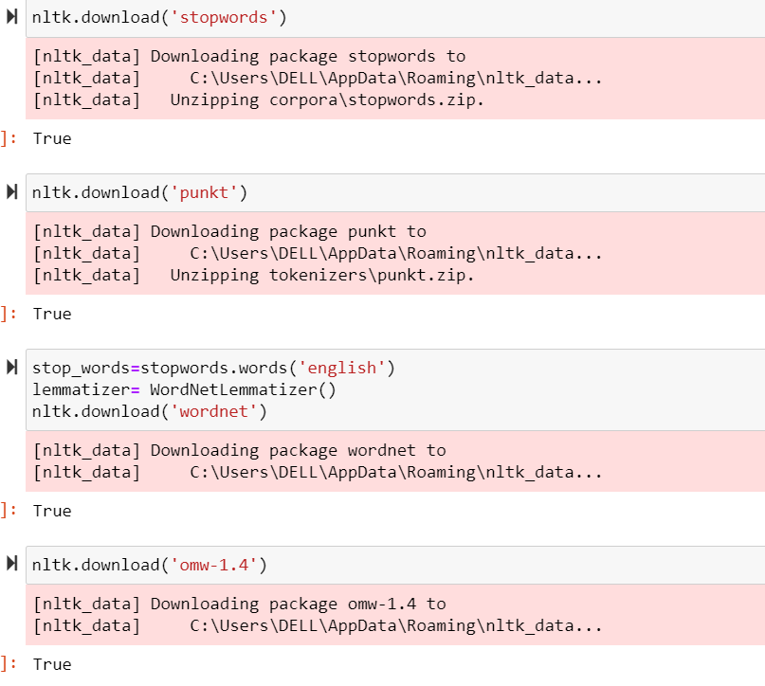
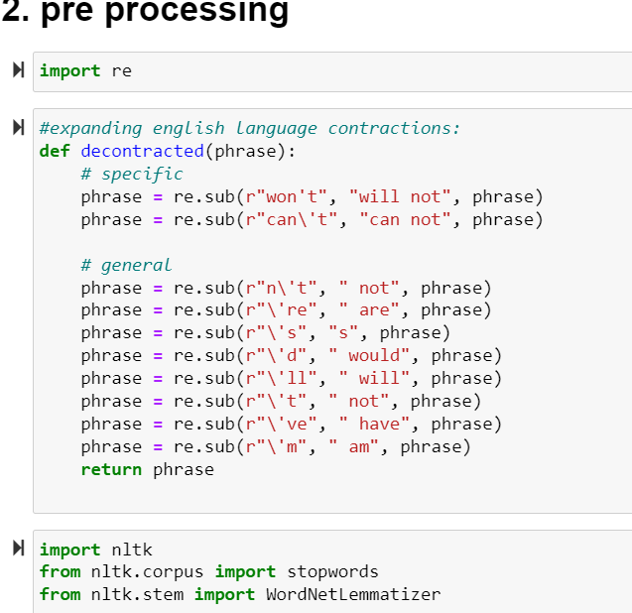
Data PreProcessing
We have comment_text, which we need to pre processed using NLP.

Slide 15
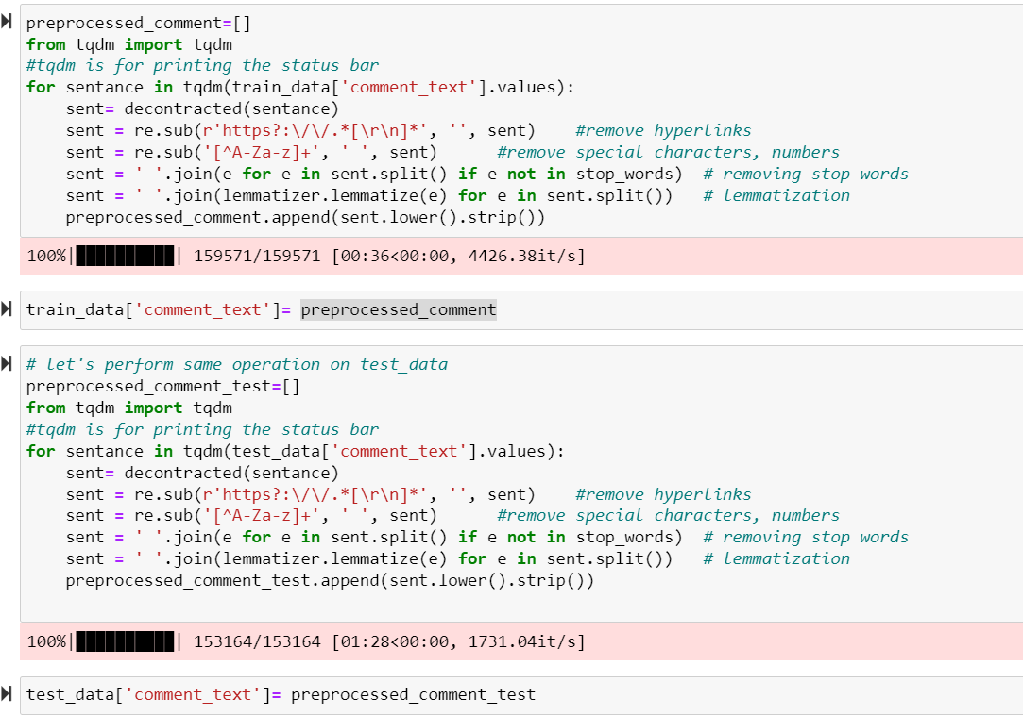
We Perform all the pre processing steps on train comment_text as well as test comment_text.

Slide 16
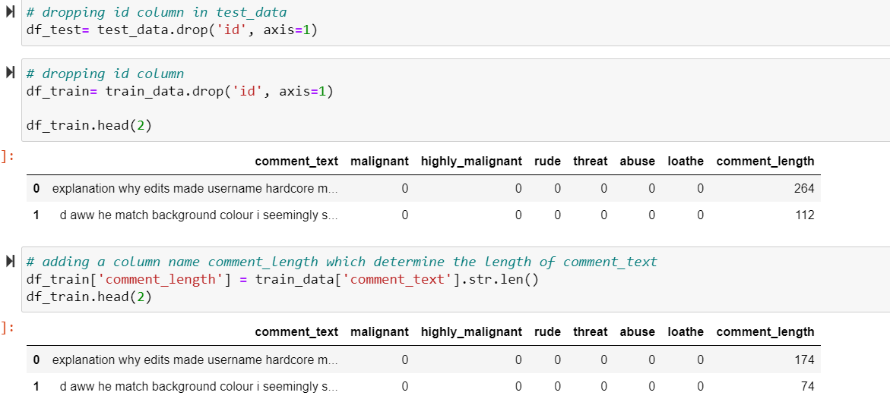
We drop Id columns from both test data and train dataset, also we check for comment_length in our pre processed text data. Where we observe that there is great decrease in the length of text, as all the unwanted words like stop words, punctuations etc, are removed from the main text to make it more manageable useful data.

Slide 17
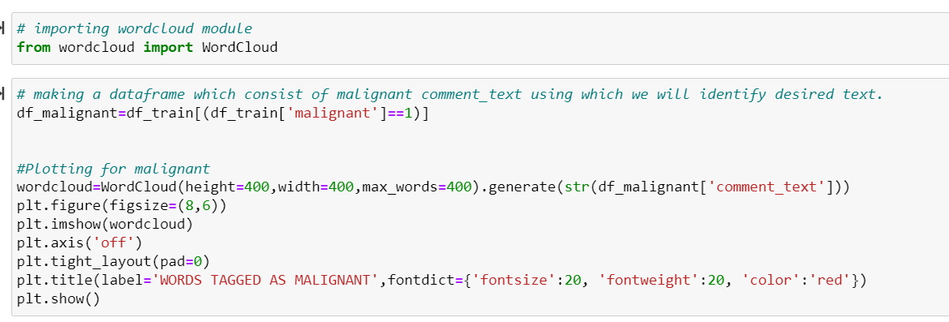
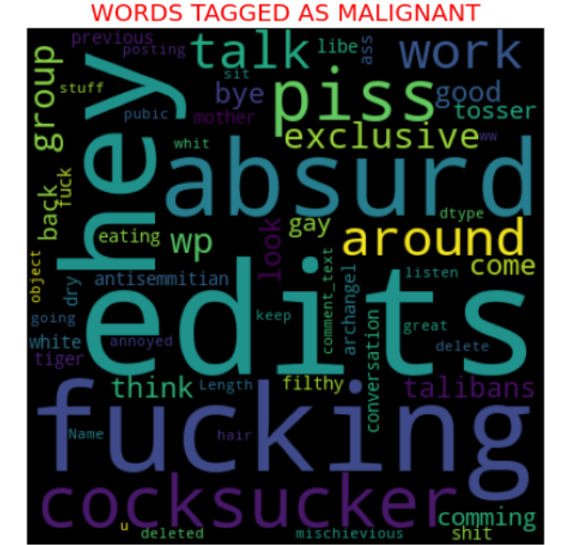
From this wordcloud we can see all the top words or tags whose presence in comment_text makes them malignant.
Large font words are most frequent words used in those hate speeches/hate comments

Slide 18
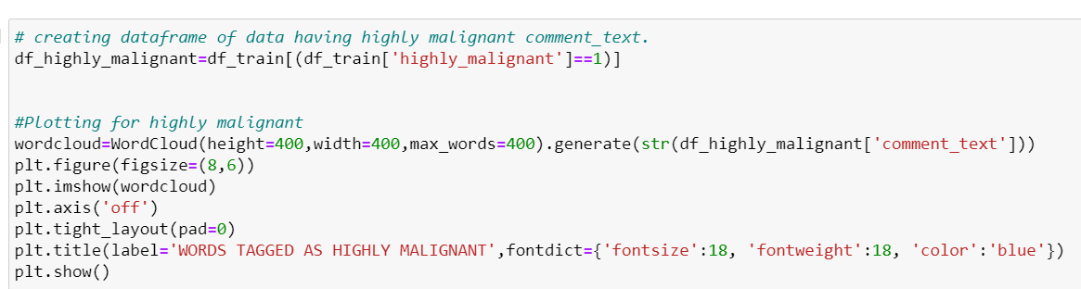
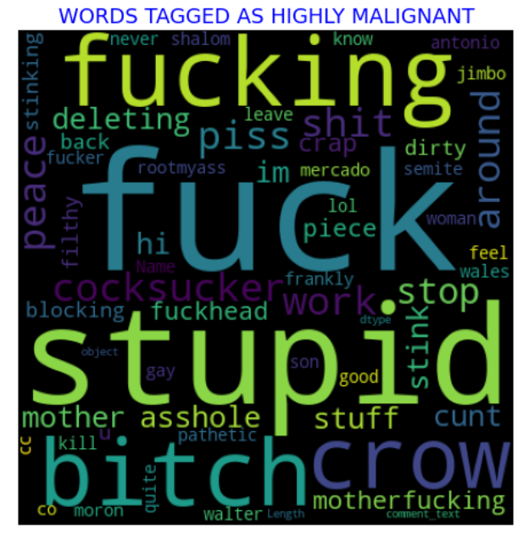
From the plot we can see what are the tags which are consisted to be highly malignant in a comment.

Slide 19
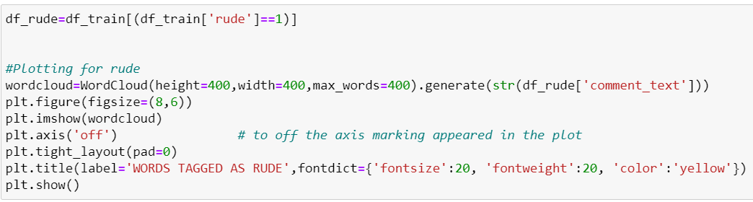
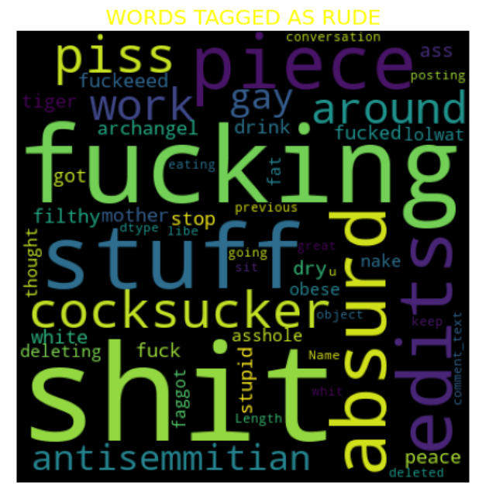
From following plot we can see all the words that are considered to be rude in a comment.
One thing to note here that there are certain words which are common for malignant, highly malignant and rude, and that obvious as all of them are unruly words. And combination of them makes a comment malignant by nature.

Slide 20
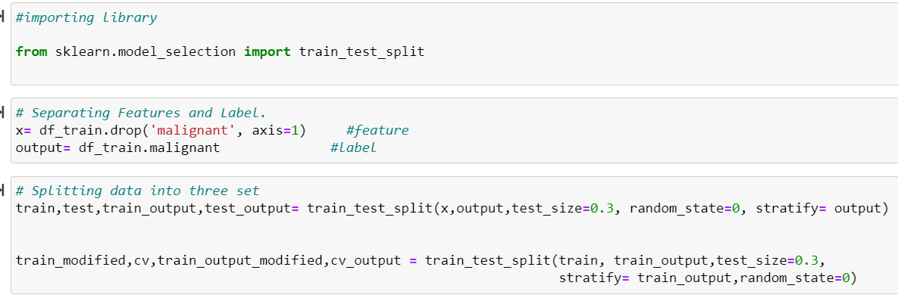
Splitting into Train, CV, Test dataset
We are splitting the data into three, in place of two dataset. Out of which we will use train and test dataset for training and testing purpose, while use cv dataset for cross validation, hence we prevent in data loss and able to evaluate on full data.
We use stratify in train test split so that the ratio of 0:1 will remain same throughout our samples. And taking test_size of 30%.

Slide 21
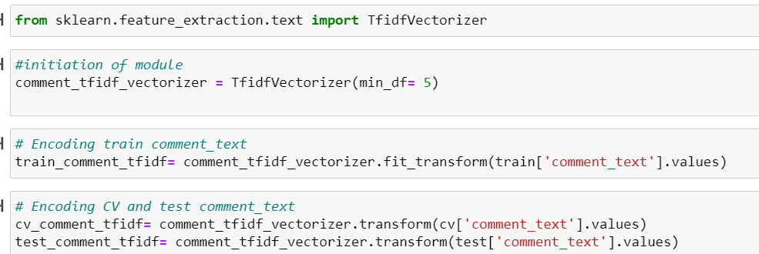
Data Encoding
As this is preprocessed text data, we will encode it using vectorization technique. For that we are using TfidfVectorizer. This encoded data is our final data which we will use in machine learning. We did similar operation with test data comment_text, to make it prediction ready.

Slide 22
Model Building
As our is a classification Problem, we follow following approaches to decide from:
Logistic Regression
Decision Tree Classifier
RandomForest Classifier
XGBoost Classifier
AdaBoost Classifier
KNeighborsClassifier
Out of these Logistic Regression is our final Model.

Slide 23
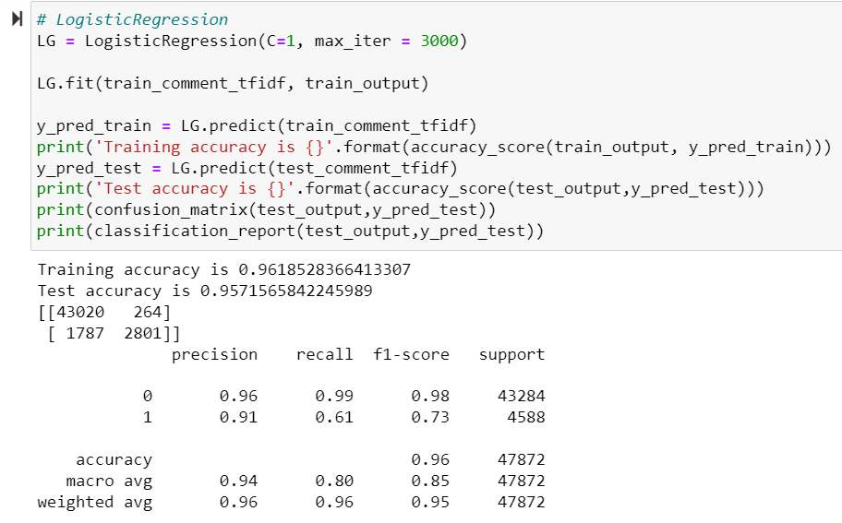
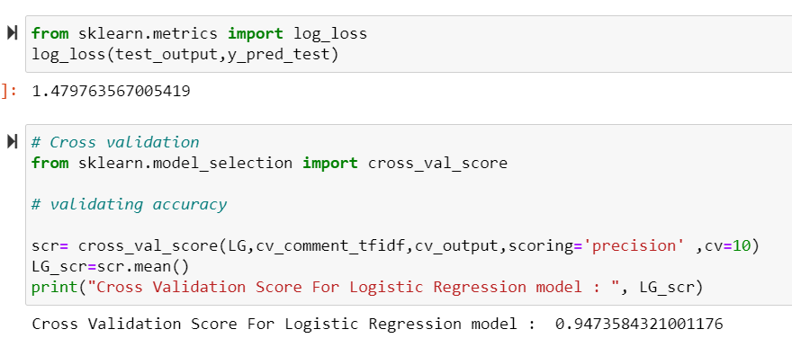
Logistic Regression

Slide 24
Observation/Interpretation:
From the logistic Model we can see that, this model is neither overfit nor underfit, as train accuracy and test accuracy is in line, we can also observe that the log_loss is also very low here
In Cross validation we use cv dataset, and precision as evaluation method, here also we can observe that our model work really well.
While Building other model we observe that Logistic regression has lowest log_loss and highest precision score. Also, when we compare the classification report of each algorithm, Loogistic Regression standout from each of them even in terms of f1-score and recall score.

Slide 25
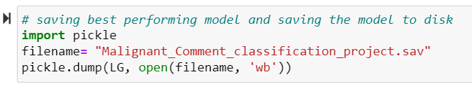
Saving the final model
For saving the final model we use pickle method. We save our file in wb form, so that when we want to predict for test data we use this loaded model as it is.
We save the LogisticRegression Model as we find them as our best fit out of RandomForest, XGBoostClassifier, AdaBoostClassifier, DecisionTree and KNN. Here we take two deciding factor, First one is log_loss and second one is Precision(Cross validation scoring) into consideration. Accuracy_score is our secondary metrics.
Classification Report helps us in justifying our final decision.

Slide 26
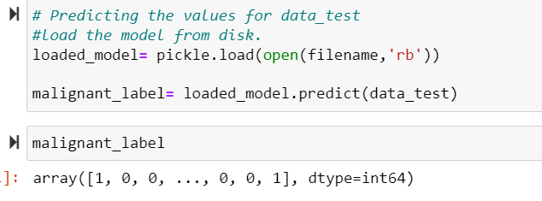
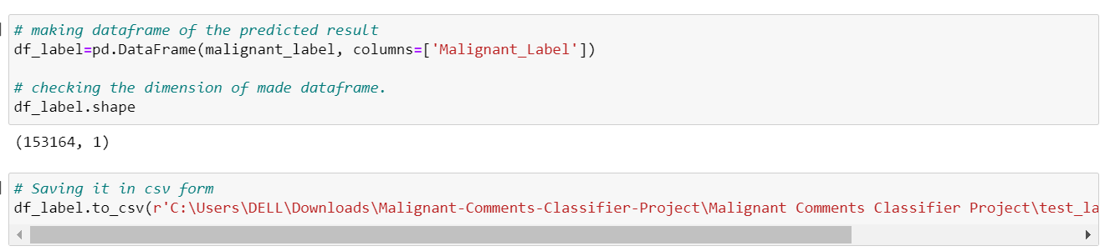
Prediction of test data using loaded model.
Here to Predict the label for test data, we load the model in rb mode, then use that in order to predict the malignant label for provided test data. Later on we go ahead and save the prediction in .csv file.

Slide 27
Conclusion
The finding of the study is that only few users over online use unparliamentary language. And most of these sentences have more stop words, and are being long. As discussed before few motivated disrespectful crowds uses these foul languages in the online forum to bully the people around and to stop them from doing the things that they are supposed to do. Our Study helps the online forms and social media to induce a ban to profanity or usage of profanity over these forms.
NLP is a great tool which helps us to work with text data, and make the maximum use of it to convert it into machine understandable form and hence helps in model building.
Our selected model on the basis of which we predicted for test dataset is Logistic Regression. And also, we store the result label in csv form.
Other model like randomforest also performs equally well with few miss.

Slide 28
Limitation of this work and scope for future work:
The limitation of the study is that we have an imbalanced data so our model learnt more about the non-abusive sentence more than the abusive sentence. Which makes our model act like an overfit model when tested with live data. And also, model tend to not identify a foul or a sarcastically foul language. Also, here our label was malignant, we can even build a model for all the other categories individually.

Slide 29
Thank you.

